Slide 1




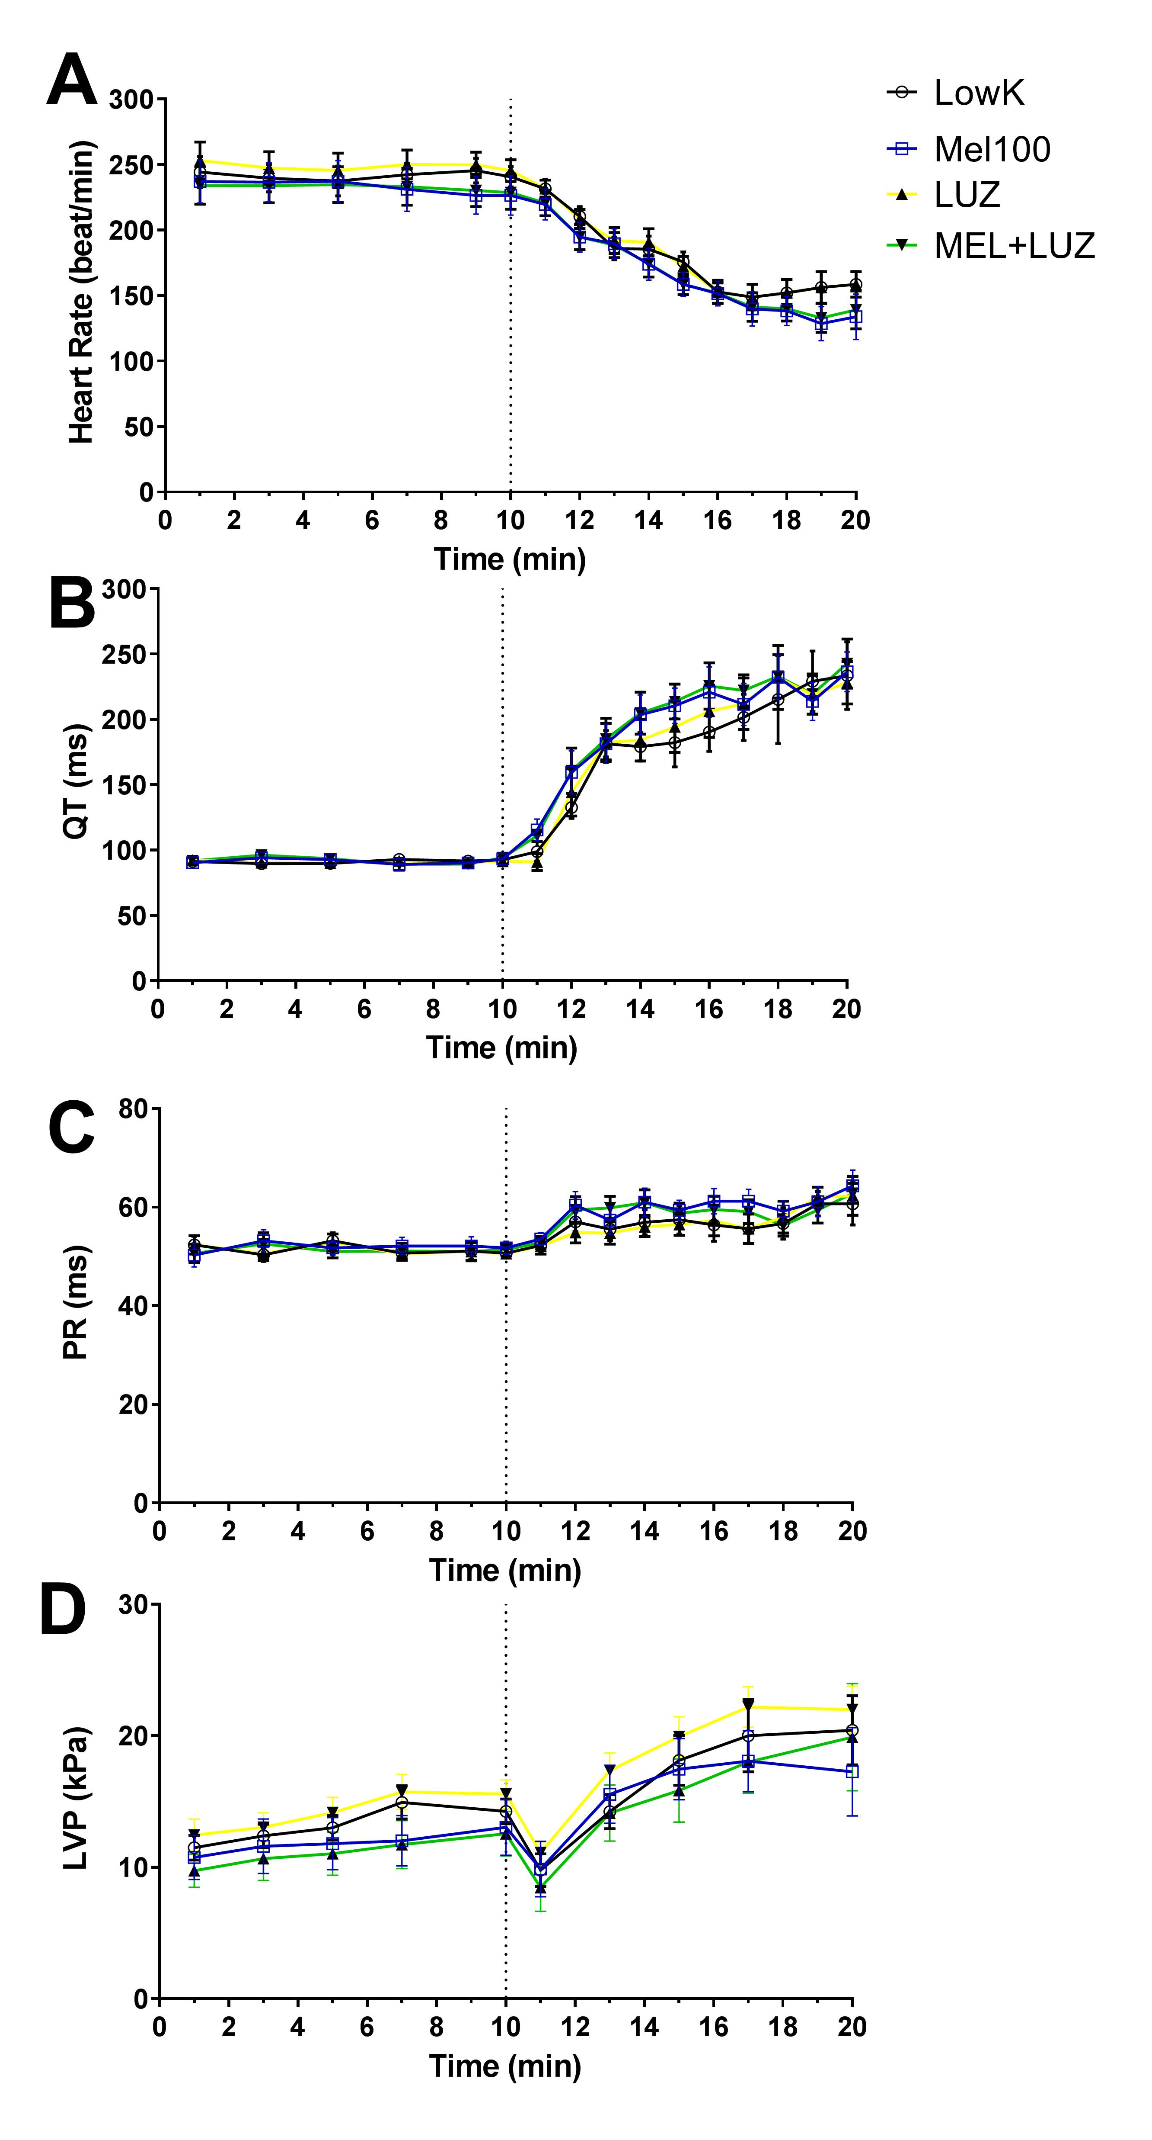
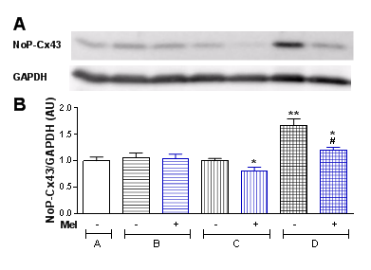
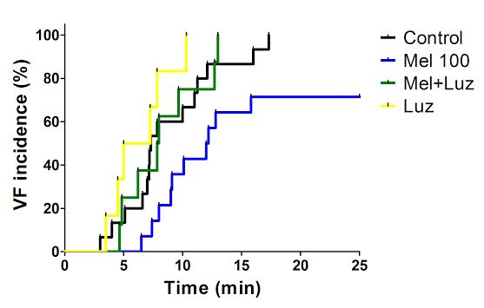
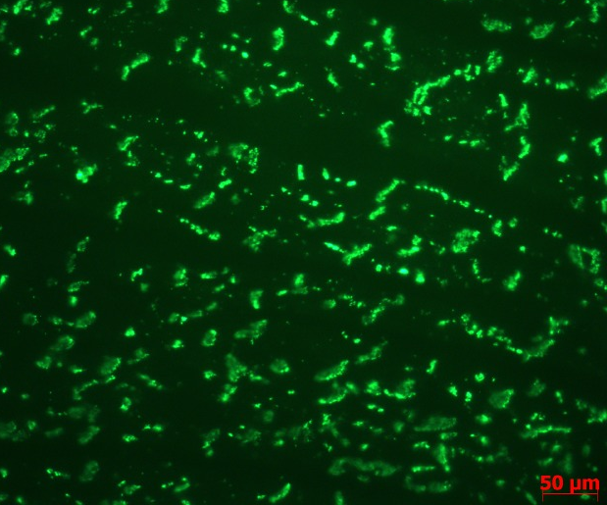
Melatonin receptors activation protects against
low potassium induced ventricular fibrillation: role of connexin-43.
Emiliano R. Diez ^{1,3}, Tamara Beňova ², Natalia Prado ³, Boris Lipták ⁴, Vladimír Knezl ⁴, Roberto Miatello ^{1,3}, Barbara Bačová ², Narcisa Tribulova ²
¹ Instituto de Fisiología, Facultad de Ciencias Médicas, Universidad Nacional de Cuyo, Mendoza, Argentina. ² Institute for Heart Research, Slovak Academy of Sciences, Bratislava, Slovakia. ³ Instituto de Medicina y Biología Experimental de Cuyo, Consejo Nacional de Investigaciones Científicas y Técnicas, Mendoza, Argentina. ⁴ Institute of Experimental Pharmacology and Toxicology, Slovak Academy of Sciences, Bratislava, Slovakia. Contact email: emiradiez@gmail.com
Introduction
Hypokalemia is the most common electrolyte abnormality encountered in clinical practice and enhances the propensity for ventricular fibrillation (VF). Melatonin up-regulates the gap junction channels protein, connexin-43 (Cx43), rendering the heart more resistant to electrically-induced VF.
We hypothesized that melatonin may protect against low potassium induced VF in part by affecting Cx43.
Fig 3. Melatonin did not affect other functional parameters. A. Heart rate, B. QT interval of the ECG, C. PR interval of the ECG, D. Left ventricle developed pressure (LVP). Values correspond to mean ± SEM.
Methods
Isolated rat hearts underwent low K+ perfusion (1 mEq/L) in 4 groups: 1) Mel, 100 μM melatonin; 2) Luz, luzindole 5 μM a melatonin receptor blocker; 3) Mel+Luz melatonin+luzindole; or 4) Control, vehicle of the drugs, according to the scheme below:
ECG and heart function were registered and analyzed using BiolabF software. Samples for western blot and immunofluorescence were taken after: stabilization, 5 min of low potassium perfusion, two min VF and, 25 min of normokalemic perfusion.
Fig 4. Melatonin prevented the unphophorylated state of Cx43. A. WB with a specific antibody against unphosphorylated Cx43. B. Densitometric quantification (n=4).* p< 0.05 and ** P<0.01 compared to control. (Below)
Control
Mel 100
Results
MEL+LUZ
LUZ
Fig 1. Melatonin was the only treatment that reduced the incidence of low K+-induced VF from 100% (vehicle 15/15; luzindole+melatonin 10/10; and luzindole 8/8) to 69% (9/13) (P=0.0349 vs vehicle by Fisher test) and delayed the occurrence of VF to 12 min (9-25 IQR) from 7 min (5-12 IQR) in vehicle group (P=0.041 by Log.rank test.).
Conclusions
Acute activation of melatonin receptors prevents of abnormal expression and distribution of Cx43 and severe arrhythmias.
Fig 2 Melatonin prevented low potasium induced lateralization of Cx43.
All authors declare no conflict of interest

